Slide 1
Manufacturing Planning Process
Lean Six Sigma
Taguchi Methods

Slide 2
Lean Six Sigma (LSS)
Improvement Methods
Design for LSS (DFSS)
LSS Implementation Issues
Strategic LSS Roadmap
The Malcolm Baldrige Award
“Quality begins with me.”
Phil Crosby

Slide 3
Six Sigma Improvement Methods
No need to choose between improvement and replacement - Six Sigma accommodates both!
Define
Measure
DMAIC
DMADV
Analyze
Continuous Improvement
Reengineering
Improve
Design
Control
Validate
“He who stops being better stops being good.” Oliver Cromwell

Slide 4
LSS Tollgates/DMAIC Checklist
Tollgate Purpose:
Review progress after each DMAIC phase
Approve transition to the next phase
to insure that the team does not rehash, regress, or fail for other reasons
Responsibility: Quality Council (Steering Team)

Slide 5
Define Tollgate Checklist
Relevant Background Information
Problem Statement/Clear Business Case
Voice of Customer
Process Description - SIPOC
Project Charter
  Project Benefits
  Resources Needed
  Source of Baseline Data
High Level Flowchart
DMADV/DFSS?

Slide 6
Measure Tollgate Checklist
Scheduled Team Meetings
Identify Measures to Collect and Analyze data
Collect Baseline Data
Control Charts for Y’s
MSA
Initial C_{pk}
RTY
Update Charter

Slide 7
Analyze Tollgate Checklist
Detailed Process Map
Process Analysis
Collect Baseline Data on X’s
Root Cause Analysis
Control Charts for X’s
Analyze X’s vs. Y’s
FMEA
Benchmarking

Slide 8
Improve Tollgate Checklist
Create Future State/Pilot Solution
Optimize Solution
Develop Implementation Plan
Improvement Significance
Obtain Approvals
Implement Improvements
Mistake Proof
Service Recovery

Slide 9
Control Tollgate Checklist
Standardize Work
Assure Change Management
Guarantee Process Capability
Obtain Management Sign-off
Implement Controls
Insure Gains
Monitor Process
Assign Process Owner
Implement a Periodic Review

Slide 10
Design for Lean Six Sigma (DFLSS)
A design process for re-engineering opportunities (DMADV)
  Objective is to design a new process with Six Sigma quality to start
  Focus is on “front-loading the pain”
Must be identified by management as major opportunities for savings and/or customer satisfaction
Projects will be longer; team members may need to be back-filled in their jobs for the duration of the project

Slide 11
Design for Lean Six Sigma (Continued)
DFLSS Dimensions:
Design for Manufacture and Assembly
Design for Reliability
Design for Maintainability
Design for Serviceability
Design for Environmentality
Design for Life-Cycle Cost
Benefits Include:
Reduced Life-Cycle Cost
Improved Quality
Increased Efficiency and Productivity
“When organizations are considering making a change, they will consider associated costs, but will not give adequate consideration to the cost of not making the change.”
Source: F. Breyfogle, Implementing Six Sigma, 2003

Slide 12
Tools
QFD, Benchmarking, FMEA, Simulation,
Optimization, Life-Cycle Planning, DOE, Taguchi Loss Functions, and Triz

Slide 13
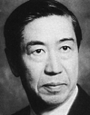
DFLSS Tools: Taguchi
Taguchi Methods are statistical methods developed largely by GENICHI TAGUCHI to improve quality of manufactured goods.
The philosophy of off-line quality control.
Innovations in the design of experiments.

Slide 14
Taguchi Loss Function
Taguchi defines Quality as “the loss imparted by the product to society from the time the product is shipped.”
LOSS = Cost to operate, Failure to function, maintenance and repair cost, customer satisfaction, poor design.
Product to be produced “being within specification”

Slide 15
Taguchi’s Vs. Traditional Approachs
Taguchi’s | Traditional
When a product moves from its Target the loss is there even if the product lies within Limits | There are Good or Bad Products only as per Limits

Slide 16
Taguchi’s Quadratic Quality Loss Function
Quality Loss Occurs when a product’s deviates from target or nominal value.
Deviation Grows, then the Loss increases.
Taguchi’s U-shaped loss Function Curve.

Slide 17
Taguchi’s U-shaped loss Function Curve.
Taguchi loss Fn
Scrap or Rework Cost.
Loss
Measured
characteristic
LTL
Nominal
UTL

Slide 18
Formula to find Taguchi’s Loss Fn
L (x) = k (x-N)²
Where L (x) = Loss Function,
k = C/d² = Constant of proportionality
d - Deviation of specification from target value
x = Quality Features of selected product,
N = Nominal Value of the product and
(x-N) = Tolerance

Slide 19
Taguchi: Loss Curve
Loss (L)
LSL
USL
Loss
No Loss
Loss
x
T

Slide 20
DFLSS Tools: Life Cycle Planning
The probability of a new product or service failure is highest in the early stages due to design or production flaws, and decreases and then levels out with usage
  e.g., initial problems with new cars or homes
However, at some point, the probability of failure increases as parts wear out
Some systems are repairable
or replaceable,
while others are not.
DFLSS planning must consider these factors
“Bathtub” Curve
Failure
Rate
Usage (time)

Slide 21
DFLSS Tools: Simulation
A method for replicating real world relationships using a few factors, simply related
Typically done with the aid of a computer
Utilizes historical data or other knowledge to make assumptions about the likelihood of future events
Allows for the study of variation in processes
Enables analysis and learning without disrupting the real system under investigation by using random numbers to “simulate” events
Not an optimization technique; decision variables are inputs to a simulation

Slide 22
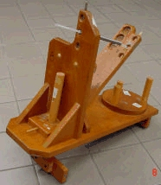
DFLSS Tools: Design of Experiments
DOE is a statistical procedure for conducting a controlled experiment, where the impact of high versus low settings of X’s are determined, including possible interactions
“Blocking” and other aspects of DOE help to reduce the needed number of trials, and remove the effect of noise factors
DOE can also be used to test the prediction quality of a DSS model
This compares to “OFAT” experiments, which take too long and cannot detect interactions!
Catapult Experiment

Slide 23
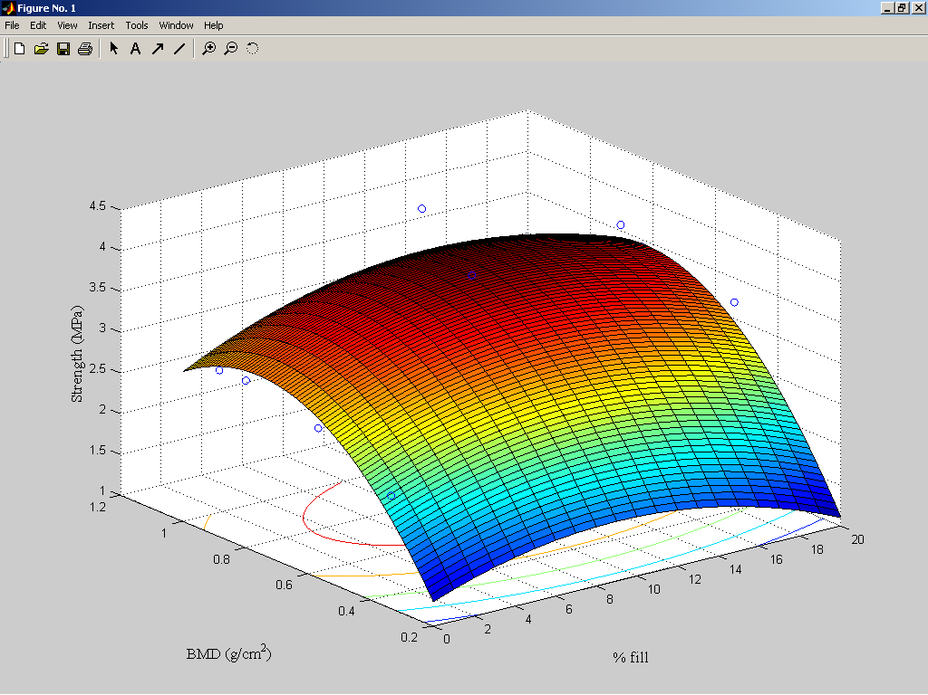
DFLSS Tools: Optimization
Objective is to find the settings for the “vital few” controllable inputs (X’s) to optimize desired results (Y’s)
Note that optimization of parts of systems can lead to sub-optimization of the whole system (e.g., Sales over-committing Operations to customers, reduced quality due to purchasing cheaper items)
Simple spreadsheet tools (such as Solver in Excel) can be used to determine the best levels of input factors to optimize a system (maximize profit, minimize costs, etc.)
Response Surface Methodology (RSM) is a sequential statistical procedure (supported by
Minitab) that combines optimization techniques and DOE

Slide 24
DFLSS Tools: Theory of Inventive Problem Solving (TRIZ)
A combination of methods, tools, and a way of thinking developed in the Soviet Union in the 1940s
Used for concept generation and problem-solving
Assumes that all inventions contain at least one contradiction
  e.g., faster auto acceleration reduces fuel efficiency, productivity vs. accuracy, etc.
Success depends on resolution of contradiction
Involves trade-off between contradictory factors, or overcoming the contradiction
  Despite the immensity of problems, only 1250 typical system contradictions in 39 design parameters have been found to date
  Many Triz tools have been developed to deal with these contradictions
Source: Design for Six Sigma, Yang and El-Haik, 2003

Slide 25
Lean and Single Supplier Strategy
Advantages
Time saved dealing with many suppliers
Larger batch sizes possible (more stable process)
Fewer changeovers; less idle time
Captive assembly lines possible; easy to schedule priorities
Supplier can demand higher quality from its suppliers due to larger quantities
More time for corrective action
Reduction in price due to quantity given to single supplier
Reduction in incoming quality rejections
Reduction in variability

Slide 26
Lean and Single Supplier Strategy
Easier to share responsibilities for quality; more commitment; better communications
Greater moral responsibility for quality from supplier
More volume available if industry shortages of materials
Simpler and faster training
Improved document and sample control (less specs, more up-to-date)
Minimized identification issues when field failures
One stop corrective actions
Reduced cost of quality (less travel, telephone costs, executive time)
More time to communicate with customers
Priority access to supplier’s R&D breakthroughs

Slide 27
Lean and Single Supplier Strategy
Fewer brainstorming opportunities and competitive benchmarking opportunities (but can offset with industry research, benchmarking, FMEA analysis, leveraging best ideas of single supplier, etc.)
Dependence on one supplier to get it right (but can use SPC for early warnings of process deviations)
Emergency breakdown at single supplier facility (can be offset with contingency planning, dormant supplier preparedness, and long-term ordering)
Potential loss of diversity of suppliers
Disadvantages

Slide 28
Other Lean Considerations
Many organizational decisions negatively impact continuous flow
Lean continuous flow is not always appropriate
  Innovative products
  Need responsiveness and flexibility
Multiple supplier relationships cannot support Lean
  Single supplier strategy is needed,
  even for critical resources
  Need to partner with a supplier
  to achieve your Lean goals!
Lean is a prerequisite to
outsourcing
Bullwhip Effect
Order Quantity
Retail Orders
Time
Wholesaler’s Orders
Manufacturer’s Orders

Slide 29
LSS Implementation Issues
Change Management
  Resistance to change
  Lack of appropriate data
  Threat of job security
  Rewards and recognition
  Training
LSS Length
LSS Buy-in
  Leadership
  Individuals and teams
Measurement of LSS Success
LSS buy-in: the LSS steering team vs. the management team

Slide 30
LSS Training Roll-Down
Start with Executive Management/Champions
  Orientation to Lean Six Sigma
    DMAIC methodology
    Key tools
    Management responsibilities
  Complete initial LSS plan after this training
  Initiate 1-2 LSS projects to begin to “walk the talk”
Develop/Purchase Training Materials
MBB/BB Training and Learning
  Develop the infrastructure for LSS training
Middle Management/Process Owners
Green Belts/Other Belts
Remaining Organization Orientation

Slide 31
Strategic LSS Roadmap
Create Vision
Identify VOC
Establish Metrics
Strategic Plan
Systems Alignment Benchmarking
Company Balanced Scorecard
Financials
Customer
Internal Process
UCL
Gap
Learning/Innovation
LCL
Business Objectives
Gap
Gap
Business Leadership
Business Measures
VSM
Select Projects
Manage Tollgates
Process Flow
Control
Process Dashboard
Improve
UCL
Process Measures
Analyze
Define
Y's
Measure
LCL
X's
Notes:
Identify and Train future Leaders

Slide 32
Baldrige Award Criteria Framework
A Systems Framework for Performance Excellence
Organizational Profile: Environment, Relationships, and Challenges
Strategic
Human Resource
Planning
Development
& Management
Leadership
Business
Results
Customer and
Process
Market Focus
Management
Measurement, Analysis, and Knowledge Management

